Slide 1
BENAZIR BHUTTO SHAHEED UNIVERSITY LYARI
Department: Computer Science Course: Artificial Intelligence Instructor: Anwar Ali Lab Topic: BERT + CSP Label Constraints (Text Classification)
Members:
Musavir Hussain
Saim Khan
Saqib Ali Brohi

Slide 2
Introduction
Organizations deal with huge amounts of documentation.
Manual classification is slow and error-prone.
We use BERT, a transformer-based NLP model, for automated text categorization.
System learns patterns from labeled data and predicts categories for new documents.

Slide 3
Problem Statement
Learn semantic patterns from documentation.
Automatically classify new text into defined categories.
Produce consistent, reproducible output.
Evaluate accuracy & generalization on unseen data.

Slide 4
Objectives
Load and preprocess dataset (CSV).
Clean text & prepare labels.
Train/test split (80/20).
Tokenize using BERT tokenizer.
Fine-tune BERT for sequence classification.
Build interactive prediction function.
Test model on new text input.

Slide 5
Dataset Overview
Dataset Columns:
text → document content
label → predefined category
Preprocessing Includes:
Removing missing values
Normalizing data
Converting labels to numeric format
Splitting into training & test set

Slide 6
Tokenization (BERT)
Before training, text is converted into BERT-compatible format:
Subword tokenization
Input IDs (numerical tokens)
Attention masks
Padding & truncation to fixed length (e.g., 128)
Wrapped into custom Dataset class for Trainer

Slide 7
Tokenizer Files Downloaded
During setup, BERT downloads essential files:
tokenizer_config.json
vocab.txt
tokenizer.json
config.json These ensure identical preprocessing during training & inference.

Slide 8
BERT Model Setup
Load BertForSequenceClassification
Set number of output labels
Model learns semantic features from text
Optimized to predict correct document categories
Uses transformer attention mechanism

Slide 9
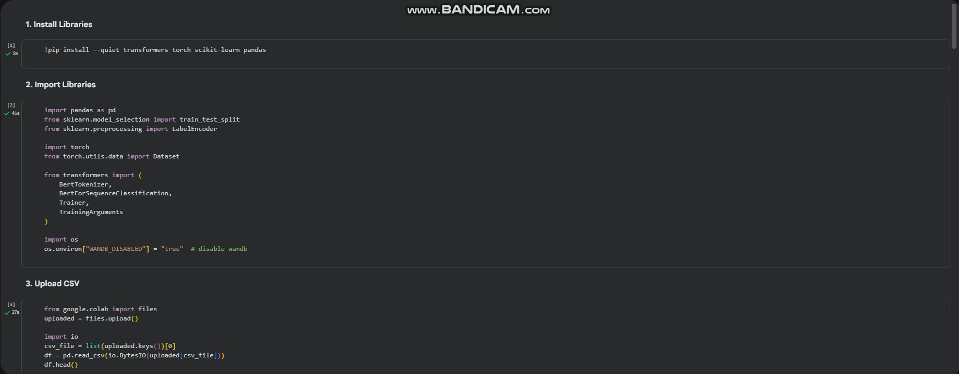
BERT + CSP Text Classification

Slide 10
Trainer Setup (HuggingFace)
Trainer components:
Model — BERT for classification
TrainingArguments — epochs, batch size, logging steps
Dataset — tokenized train & test sets
Trainer handles:
Gradient updates
Logging
Evaluation
Checkpointing

Slide 11
CSP Label Constraints (Concept)
CSP = Constraint Satisfaction Problem applied to labeling. Used for:
Enforcing label consistency
Ensuring predictions follow defined constraints
Avoiding invalid label combinations
Improving structured classification tasks
Example: If “Technical Report” must also include “Documentation” → CSP ensures this.

Slide 12
Saving Model & Tokenizer
After training:
Save model weights (e.g., ./results/)
Save tokenizer for consistent future preprocessing Provides:
Reusability
Avoids retraining
Portability across systems

Slide 13
Prediction on New Text
Steps for inference:
Tokenize input text
Pass through trained BERT
Generate logits
Apply argmax to get predicted category
Convert numeric label to readable label
Used for:
Interactive testing
Classifying any new document

Slide 14
Conclusion
Demonstrated BERT-based document categorization workflow.
Covered preprocessing → tokenization → training → evaluation → inference.
BERT + CSP improves accuracy and consistency.
Model is capable of automatic, reliable classification of unseen text.
Key Takeaways: ✓ Preprocessing & tokenization are essential ✓ Fine-tuning empowers domain-specific accuracy ✓ Model is reusable & scalable

Slide 15
Do You Have Any Questions?
Thank You! We appreciate your time and attention.
If you have any questions, feel free to ask! We are happy to explain anything related to:
BERT Model
Tokenization
Training & Evaluation
CSP Label Constraints
Prediction Function
Dataset & Preprocessing
Do you have any questions?

